Slide 1

A Major Project Proposal On
VeriFact - Detection, Tracing and Tracking of Health Misinformation
Submitted in Partial Fulfillment of the Requirements for
The Degree of Bachelor of Engineering in Information Technology
Under Pokhara University
Submitted By:
Aman Sheikh, 211506
Prashanta Rokaya, 211528
Shikshya K.C, 211541
Shreya Khanal, 211546
INTRODUCTION
Detection, Tracking and Tracing of Health Misinformation is a system designed to help users verify health related claims found on social media. It analyzes text, images to identify whether the information is misleading or not. The system also traces where the misinformation likely originated from and tracks how it spreads across the platforms. In this presentation, we will explore problems and motivation, objectives, project scope and limitations.

Slide 2
A Major Project Proposal On
VeriFact - Detection, Tracing and Tracking of Health Misinformation
Submitted in Partial Fulfillment of the Requirements for
The Degree of Bachelor of Engineering in Information Technology
Under Pokhara University
Submitted by:
Aman Sheikh, 211506, Prashanta Rokaya, 211528, Shikshya K.C, 211541, Shreya Khanal, 211546
INTRODUCTION
Detection, Tracking and Tracing of Health Misinformation is a system designed to help users verify health related claims found on social media. It analyzes text, images to identify whether the information is misleading or not. The system also traces where the misinformation likely originated from and tracks how it spreads across the platforms. In this presentation, we will explore problems and motivation, objectives, project scope and limitations.
PROBLEM STATEMENT
Rapid circulation of false health misinformation on social media
Limited ability for individuals to verify authenticity of health related claims
Few tools that help understand where health claims came from

Slide 3
INTRODUCTION
Detection, Tracking and Tracing of Health Misinformation is a system designed to help users verify health related claims found on social media. It analyzes text, images to identify whether the information is misleading or not. The system also traces where the misinformation likely originated from and tracks how it spreads across the platforms. In this presentation, we will explore problems and motivation, objectives, project scope and limitations.
PROBLEM STATEMENT
Rapid circulation of false health misinformation on social media
Limited ability for individuals to verify authenticity of health related claims
Few tools that help understand where health claims came from
OBJECTIVES
Detect misleading or false health related claims
Extract claims from text, images
Retrieve evidence from sources like WHO, CoAID, CDC
Trace the likely origin of misinformation
Track how the misinformation spreads online

Slide 4
PROBLEM STATEMENT
Rapid circulation of false health misinformation on social media
Limited ability for individuals to verify authenticity of health related claims
Few tools that help understand where health claims came from
OBJECTIVES
Detect misleading or false health related claims
Extract claims from text, images
Retrieve evidence from sources like WHO, CoAID, CDC
Trace the likely origin of misinformation
Track how the misinformation spreads online
SCOPE
Focus on health misinformation across social media posts
Use a curated set of verified datasets for claim verification
Provide results through mobile application interface
Implement AI and OCR based detection

Slide 5
OBJECTIVES
Detect misleading or false health related claims
Extract claims from text, images
Retrieve evidence from sources like WHO, CoAID, CDC
Trace the likely origin of misinformation
Track how the misinformation spreads online
SCOPE
Focus on health misinformation across social media posts
Use a curated set of verified datasets for claim verification
Provide results through mobile application interface
Implement AI and OCR based detection
LIMITATION
Accuracy depends on availability and quality of reliable evidence online
Cannot verify claims in unsupported languages
Real time tracking limited by social media platform restrictions
Provides reliability of information only; not medical advice

Slide 6
SCOPE
Focus on health misinformation across social media posts
Use a curated set of verified datasets for claim verification
Provide results through mobile application interface
Implement AI and OCR based detection
LIMITATION
Accuracy depends on availability and quality of reliable evidence online
Cannot verify claims in unsupported languages
Real time tracking limited by social media platform restrictions
Provides reliability of information only; not medical advice
METHODOLOGY

Slide 7
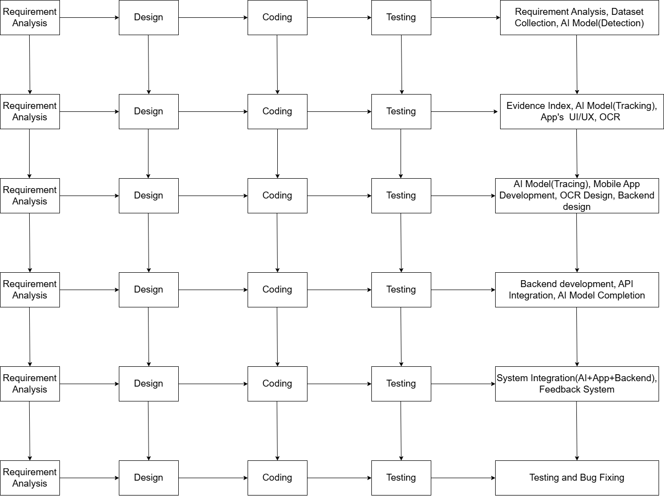
LIMITATION
Accuracy depends on availability and quality of reliable evidence online
Cannot verify claims in unsupported languages
Real time tracking limited by social media platform restrictions
Provides reliability of information only; not medical advice
METHODOLOGY
SDLC
Incremental Model Overview:
Approach involves breaking down development into smaller increments.
Phases: Requirement Analysis, Design, Implementation and Testing
First Increment: Dataset gathering and UI Design
Dataset gathering using platform like Kaggle
Dataset collected to train model was 'Job Recommendation based on JD' from Kaggle
UI design groundwork using Figma
Second Increment: Model Training and User Authentication
Model trained using attributes such as skills, industry and domain knowledge.
User Authentication and Authorization is integrated by creating signup/login page

Slide 8
METHODOLOGY
SDLC
Incremental Model Overview:
Development broken into smaller, manageable six increments
Each increment adds new functionality to the system
Key Features:
Modular development enables gradual improvement
Early prototype provides quick feedback
Reduces risk and manages complexity
Integrates AI, OCR and mobile application

Slide 9
INCREMENT 1
Collect datasets and define system requirements
Develop preliminary AI model for health misinformation detection
Prepare technical documentation
Increment 2
Increment 4
Increment 1
Increment 3

Slide 10
INCREMENT 2
Design evidence indexing system
Start mobile application UI/UX development
Begin AI model for tracking misinformation
Research OCR module
Increment 6
Increment 2
Increment 5
Increment 4
Increment 3

Slide 11
INCREMENT 3
The About Us page shares our bakery's story, rooted in a passion for baking and a commitment to quality.
Customers get a glimpse of the bakers behind the scenes and the love they pour into every creation.
Develop core mobile application
Begin OCR module design
Develop AI model to trace misinformation
Backend design initiation
Increment 6
Increment 3
Increment 5
Increment 4

Slide 12
INCREMENT 4
Complete backend development
Integrate APIs for AI, OCR and mobile application
Finalize AI model
Increment 4
Increment 6
Increment 5

Slide 13
INCREMENT 5
Integrate AI, mobile app and backend
Implement feedback collection system
Increment 5
Increment 6

Slide 14
INCREMENT 6
Complete system testing
Identify & fix bugs
Prepare deployment-ready build
Increment 6
Implementation

Slide 15
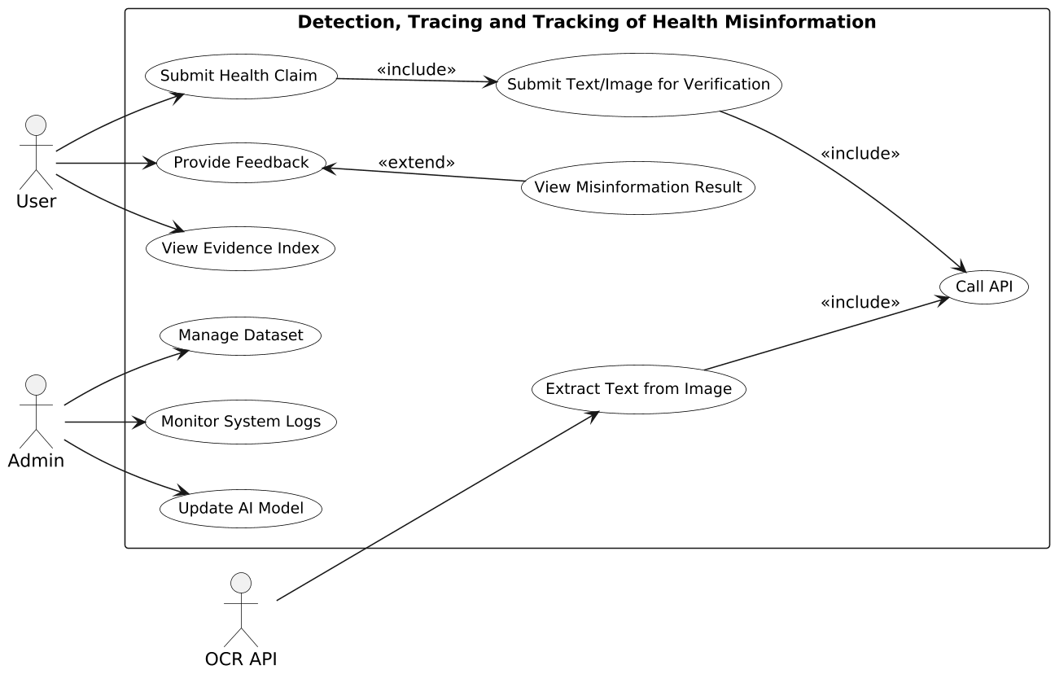
Use-Case
Diagram
Level-0 DFD Diagram

Slide 16
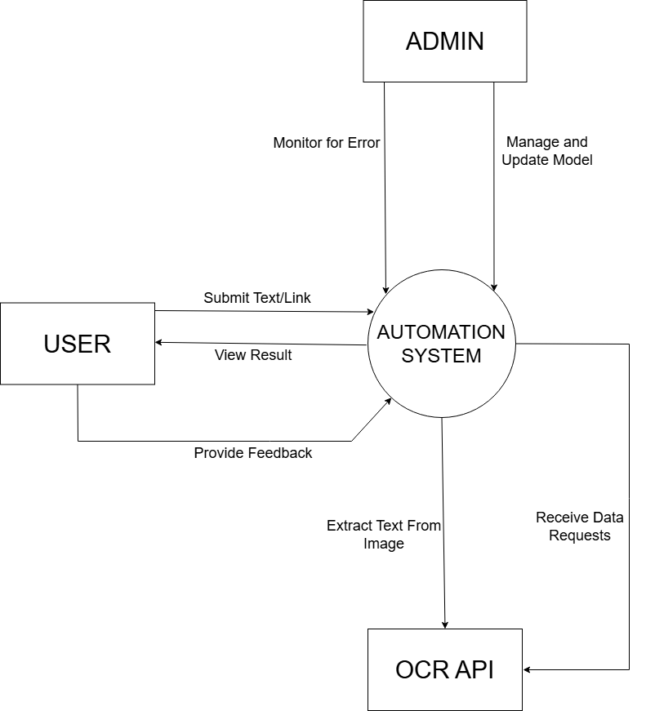
Use-Case
Diagram
Level-0 DFD Diagram
Sequence Diagram

Slide 17
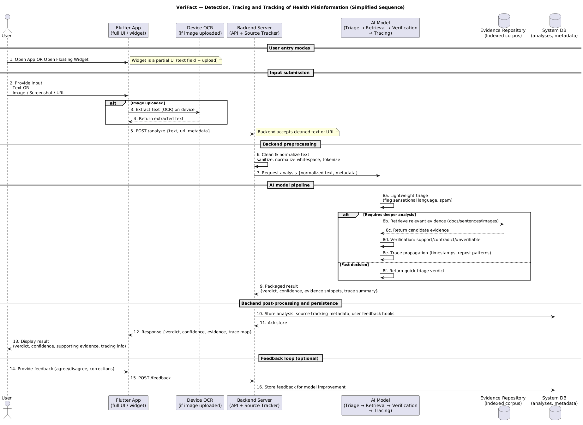
Level-0 DFD Diagram
Sequence Diagram

Slide 18
PROPOSED DELIVERABLES
GANTT CHART
AI Model
Misinformation Detection Module
Mobile Application
Tracing & Tracking System
Technical Documentation

Slide 19
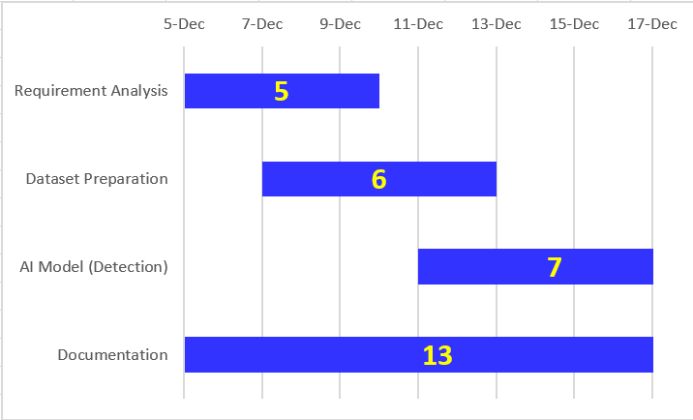
PROPOSED DELIVERABLES
GANTT CHART
AI Model
Misinformation Detection Module
Mobile Application
Tracing & Tracking System
Technical Documentation
For Iteration 1
Fig: Gantt Chart

Slide 20
GANTT CHART
For Iteration 1
Fig: Gantt Chart

Slide 21
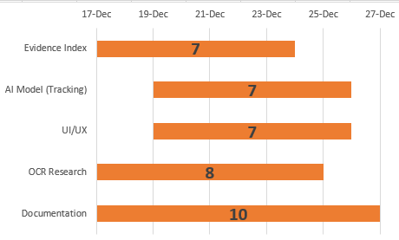
For Iteration 2
Fig: Gantt Chart

Slide 22
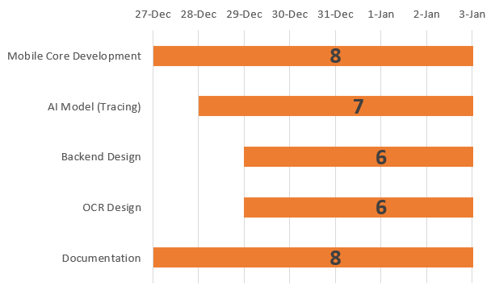
For Iteration 3
Fig: Gantt Chart

Slide 23
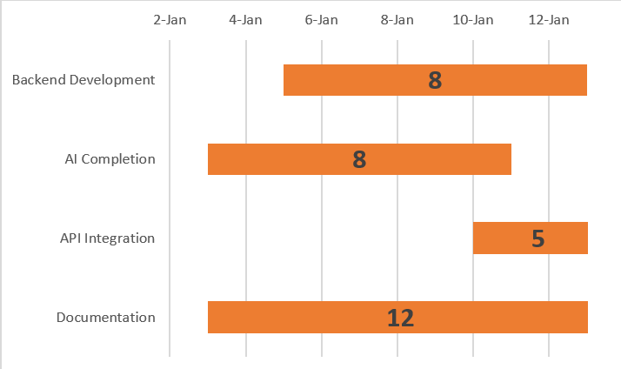
For Iteration 4
Fig: Gantt Chart

Slide 24
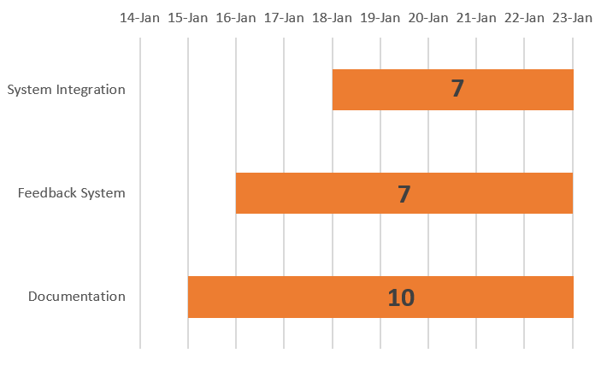
For Iteration 5
Fig: Gantt Chart

Slide 25
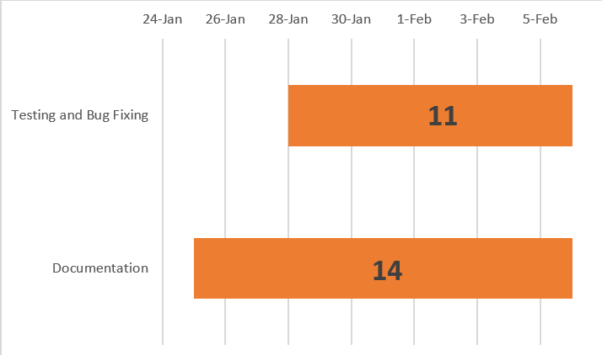
For Iteration 6
Fig: Gantt Chart

